Slide 1
St John Ambulance NSW
CULTURAL CHANGE JOURNEY
2017 to 2018

Slide 2
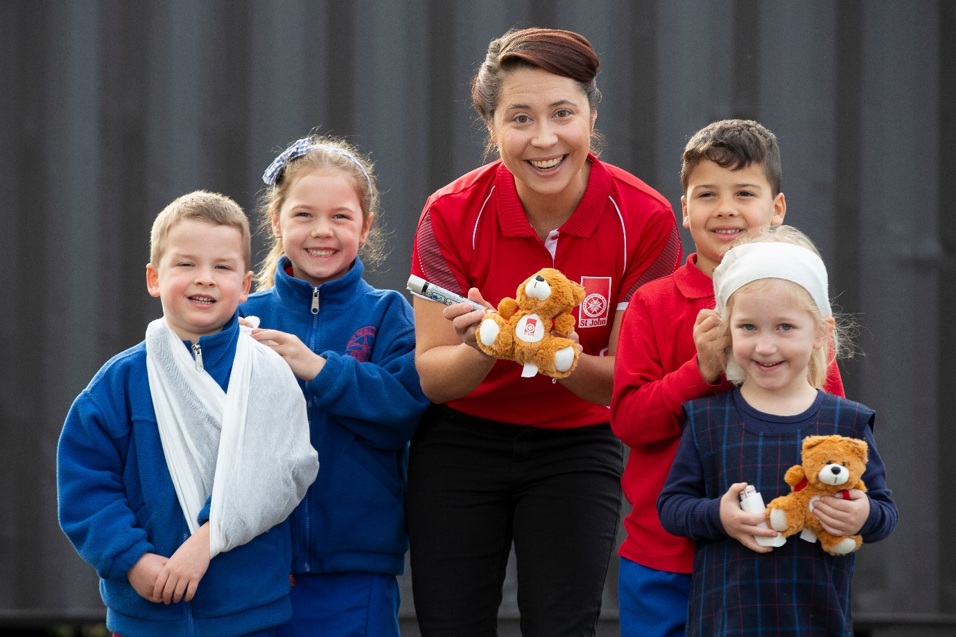
Who is St John Ambulance (NSW)
Profit for Purpose
Commercial Activities
Products: Defibrillator and First Aid Kits; Restocking and Retail Sales
Training: Provide First Aid, Asthma and Anaphylaxis, Mental Health First Aid, Education and Care First Aid, Low Voltage Rescue, Occupational First Aid, CPR and more
Fundraising, Grants and Bequests
Event Health Services: Major Events, Stadium Services
Community Activities
Community CPR and resilience training
First Aid in Schools
Event Health Services: Local community events
Emergency Response in disaster: Triage, Evacuation

Slide 3
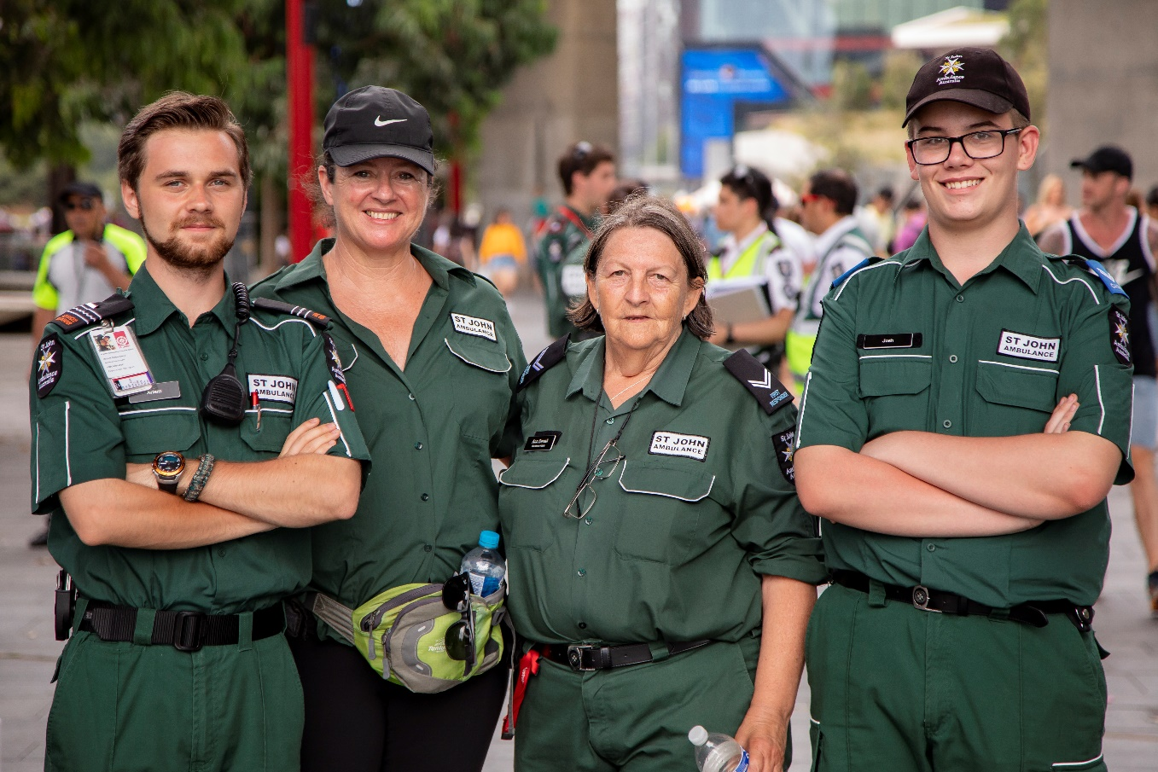
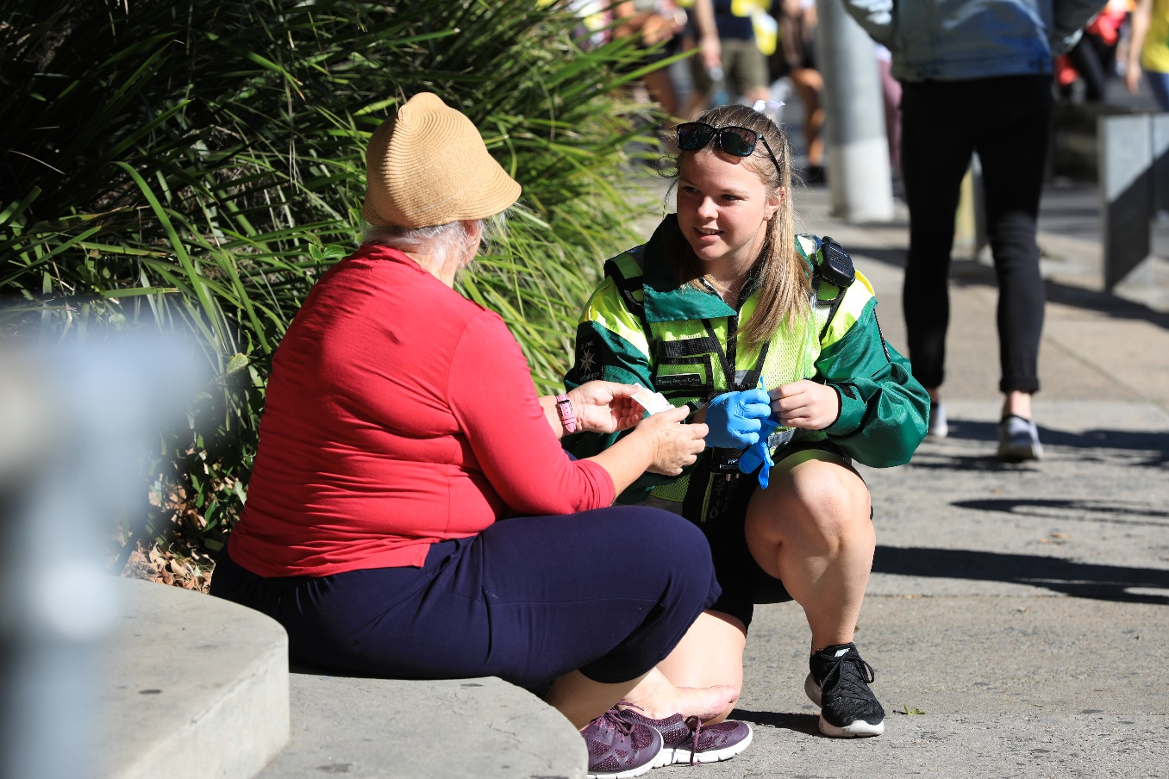
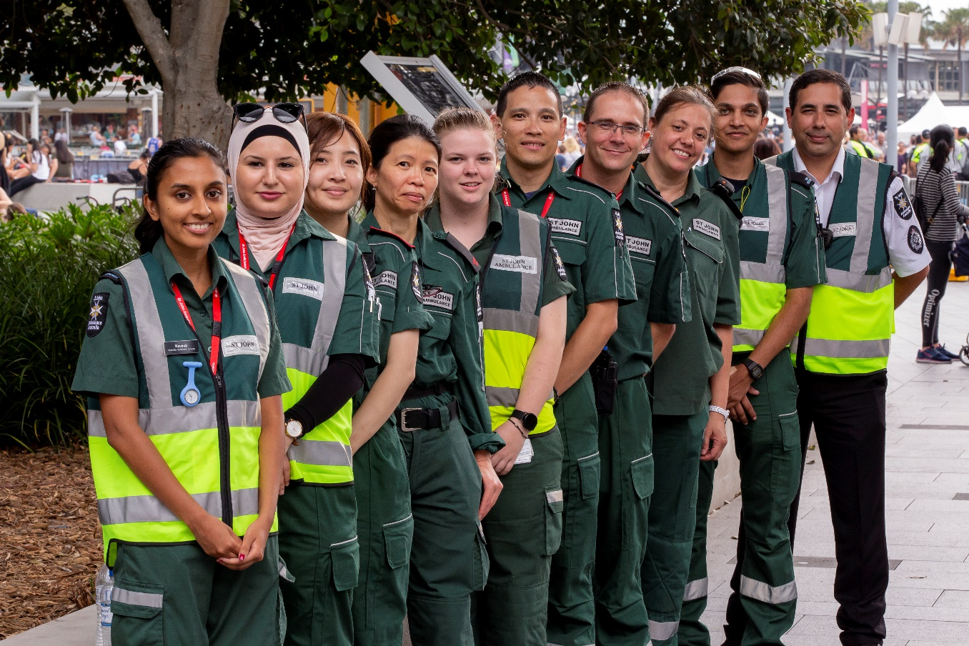
Who is St John Ambulance (NSW)
The team is made up of:
200 Staff
3,542 Volunteers split into 80 divisions across NSW
Volunteering 222,000 hours at 5,000 events
Treating over 13,000 people

Slide 4
Why we started the journey
Siloed organization with significant senior leadership conflict
The Commissioner for Volunteering resigned as he felt that he had no voice on the Board
The Board became factional as Director frustration and concern for the organisations culture increased
Volunteers became angry with no avenue to voice their frustration
The Voice Project was instigated by a new subcommittee of the Board
The CEO and 2 Board members (including the Chair) resigned

Slide 5
2017 Voice Survey Results
Passion
Progress

Slide 6
So what did we do:
Appointment of CEO, Commissioner and GMPPC; refresh of Board
Release of results through Town Hall discussions
Vision, Values and Behaviours Workshop
Board, Executive and Volunteer Leadership Strategy Session
Divisional Managers Workshops

Slide 7
Meeting with Stakeholders to talk about the issues we faced
Board, Executive, Senior Management, Senior Volunteer Leadership
State Council (Member representatives)
12 Town Hall sessions across NSW
Agenda: Results: Good, Bad and the Ugly Discussion: Unleashing the built up anger Part 2 – vision for the Future

Slide 8
Create a shared vision for St John

Slide 9
St John NSW Values
Our values define who we are. They guide our actions and behaviour.
They influence the way we work with each other, our customers and communities.
Respect
We are ambassadors for St John. We are respected for the work that we do and the way that we do it. We recognise our strength comes from our diversity. We have the courage to be authentic and true.
Integrity
We do the right thing. We are honest and trustworthy. We are accountable for our actions and take ownership of our shared goals. We are there when you need us. You can depend on us.
Leadership
We are the custodians of our future. We enable our teams to grow and succeed. We lead by example and learn from our mistakes. Our passion and commitment engage and inspire.
Communication
We are sincere in our voice and actions. We share ideas and listen to each other, our customers and community. We are open and transparent in all that we do.
Collaboration
We work best when we work together. We care for our colleagues and our community. We take initiative, generate new ideas and embrace change. We share success. Together we can make a difference.

Slide 10
Bringing each step back
Once the values were written we had to make them real and actionable
Back to -
Board and Council
Staff
Divisional Managers
What does good look like – what does bad look like?
How do we embed our values in our culture – make them real?

Slide 11
Alignment of the Board, Executive and Volunteer Leadership
Strategy Session to collectively answer the following questions:
What difference do we want to make in the communities we serve?
What are the key 4 or 5 strategies, that we all agree on, that have to happen over the next two to three years?
If we do a brilliant job at these 4 or 5 things, will this position us to handle anything the future might throw at us?
These strategies must position us so that we can deliver on our vision and create the future for the communities that we serve.

Slide 12
St John NSW Strategic Framework
Mission
To save lives through first aid
Vision
We aim to have at least one person educated, equipped and prepared to provide first aid in every home, workplace and public gathering.
INTEGRITY You can depend on us RESPECT We are respected for the work that we do and the way that we do it LEADERSHIP We lead by example COMMUNICATION We share ideas and listen to each other COLLABORATION Together we can make a difference
Values
ENGAGE
ENABLE
REIMAGINE
FUTURE
Strategic Goals
We are thought leaders and influencers. We build strong partnerships and develop key relationships. We create opportunities.
We have a common vision that drives us and shared values and behaviours that support us. We have all the tools we need to succeed.
We understand who we are and the impact of our work. We view the world through our customer and communities eyes. We are innovative.
We are the custodians of St John NSW. We have the responsibility to ensure its sustainability. We are relevant.
St John is the partner of choice
Problems are solved with our stakeholders: volunteers, government, corporate
NSW builds pathways to work with other St John States and Territories Volunteers are ambassadors in our community
Core systems, structures and processes are simplified and standardised Values and behaviours are explicit and engaging Volunteering is easy and flexible
The organisation works as one, for a common goal
It is clear what St John Stands for and its value to its partners and the community
Services are tailored to individual, corporate and local community needs Technology is leveraged to enhance our customer experience
Our structure is designed to meet our future needs
New business lines are developed and invested in Revenue streams are diversified
Fundraising increases the breadth and reach of our social impact
Pathways and opportunities for volunteers and staff are well-defined and build capability
Strategic Initiatives

Slide 13
2018 and Beyond
FUTURE PROOF
NEW
RE-IMAGINE
EMERGING
ENABLE
CORE
ENGAGE
2018 TRUST AND CAPABILITY
2019 RESPECT AND CAPACITY
2020 LEADERSHIP
AND REACH

Slide 14
Our Journey
2020 finds St John Ambulance in a leadership position. We are thought leaders and market leaders. We are proud of the work we do and how we are perceived. St John has formalised relationships with key organisations such as NSW Ambulance. Recognised by our peers, St John is seen as the leader in First Aid and is invited to the table for industry decision making and advocacy.
2019 is about building our capacity for growth. We have a solid foundation of core business and community programs. We have the ability to grow based on the respect we are held in by our community and our peers.
2018 is a year to reinvest in our people and our systems. We need to build a values-based organisation that is built on trust and respect for all the members of St John and between all the members of St John. We have started our journey and the foundation is in place, we know who we are and what we need to achieve, we are clear on our vision.

Slide 15
2018 and Beyond
NEW
Uncover options for
FUTURE PROOF
EMERGING
Resourcing initiatives to build new businesses
future opportunitites
RE-IMAGINE
CORE
Execute to defend, extend and increase profitability of current business
ENABLE
ENGAGE
2018 TRUST AND
CAPABILITY
2019 RESPECT AND CAPACITY
2020 LEADERSHIP AND REACH

Slide 16
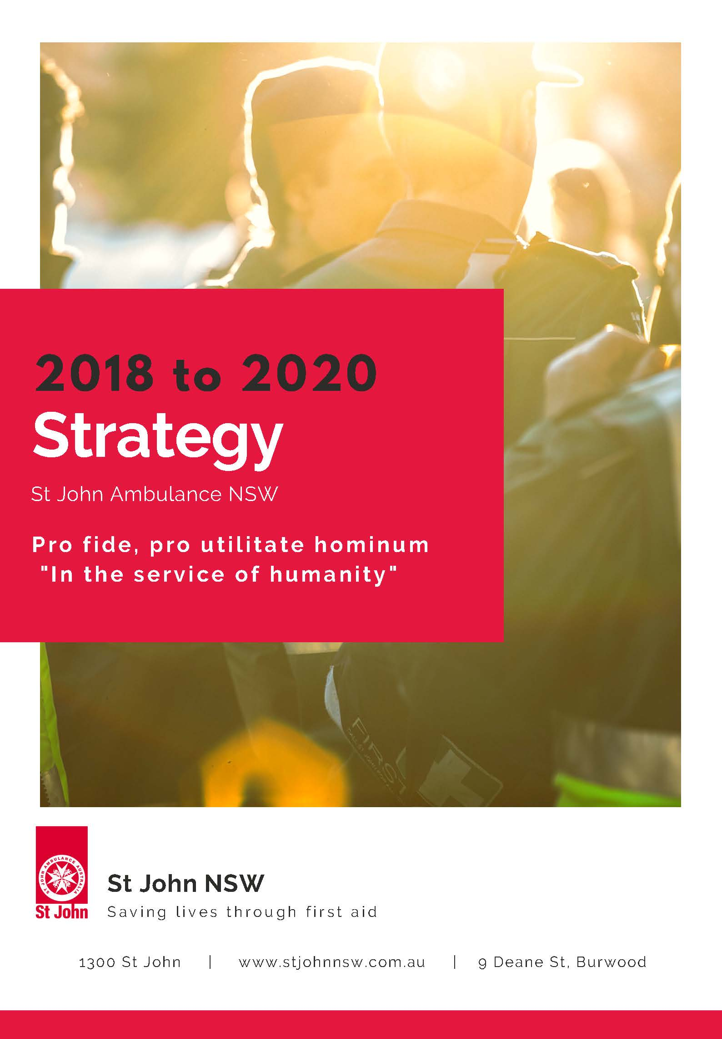
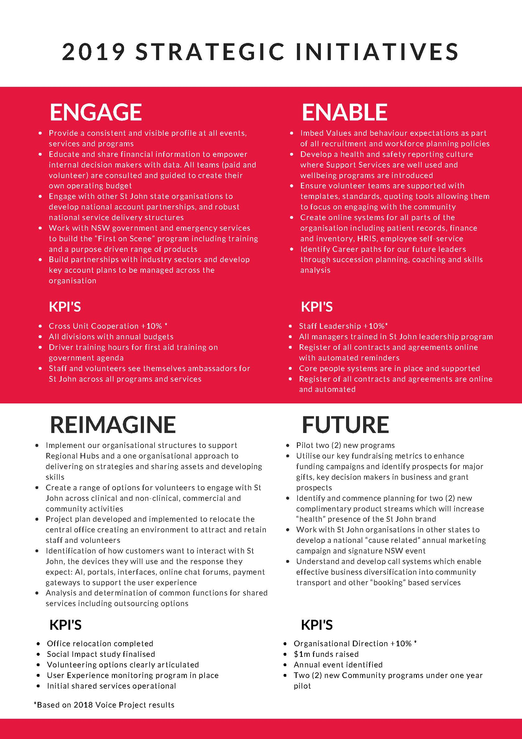
Our 2018 to 2020 Strategy

Slide 17
Reporting back to Divisional Managers
July 2018
Overall income has increased 16% on the same period last year
First Aid Product Sales up 32%
Training Revenue up 8%
Increased Investments returns
Events Income steady

Slide 18
2018 Progress Report
Welcome, retirement, thank you letters
ENGAGE
Refreshed NSW Member website
with online applications
MOU with VRA signed for First Aid training; Strategy session set for January with NSW Ambulance
Develop a member recruitment, engagement
and retention platform
Established strong relationship with NSW Governor & Mrs Hurley
Identify and expand key Emergency Service relationships, community, corporate and government partnerships and industry champions
‘First on scene’ learner driver training proposal to government stay safe committee
Funding of Invictus Games safe place solution through icare
Ad developed utilising WA regional ad; reworking WA First Responder Ap
2 year contracts negotiated with Supercars, City of Sydney NYE, Fairfax & Easter Show
Open communication with all states and territories to develop a common infrastructure and identify key shared services
MOU with Victoria to review back office activities as shared services
– cost reduction and improved performance
Shared Fundraising resource with VIC; set of 8 initiatives being worked on collaboratively across the states and territories
New Members Web live – information, policy and procedures accessible
Build forums and frameworks across NSW to enhance communication, active participation and knowledge sharing
VIP as one source of contact and communication
#MustShareMonday

Slide 19
Flexible volunteering
Timely approvals
Communication/sharing between divisions
Divisional Forum
Divisional role clarity
Financial support and system
Recruitment/induction/ selection
Academy on steroids
Who’s who in the zoo?
Adult/cadet collaboration
Feedback and Action Planning
OIC workbook
Leading values conversations
Health and safety
Communication network
Access to resources easily
Working together
Centralised collateral and information point
Member recognition
Bloody awful joining letter
Real leadership development and support
Confidence I will be supported in dealing with issues
IT access/ support
On-line training packages
Current policies and procedures

Slide 20
How we take action
ENGAGE
ENABLE
REIMAGINE
FUTURE PROOF
We listen to stakeholders views and bring people on the journey.
We detangle our environment and make St John easier to work with.
We don't throw the baby out with the bathwater but we continually look for better ways of doing things.
We have to be sustainable if we want to be here for another 150 years.
We are gaining momentum and we
need to make every action count.

Slide 21
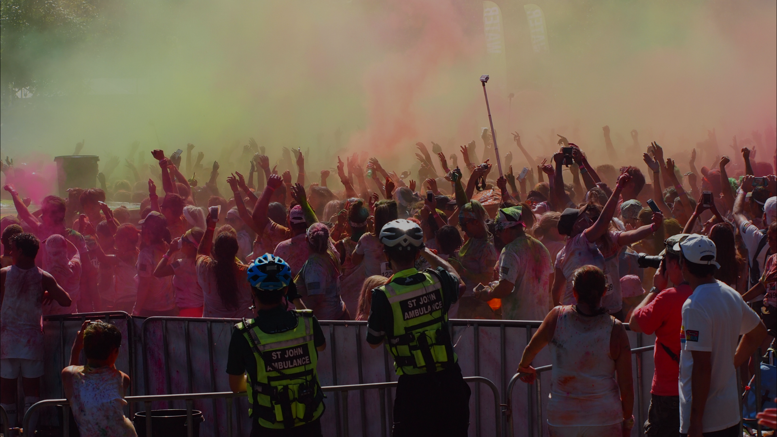
Core Projects that underpinned the change

Slide 22
Not working as one team
There is cooperation between Volunteers & Corporate
Information and knowledge is shared between Volunteers & Corporate
Information and knowledge is shared between Corporate Teams
Information and knowledge is shared between Volunteers
Volunteer
Corporate

Slide 23
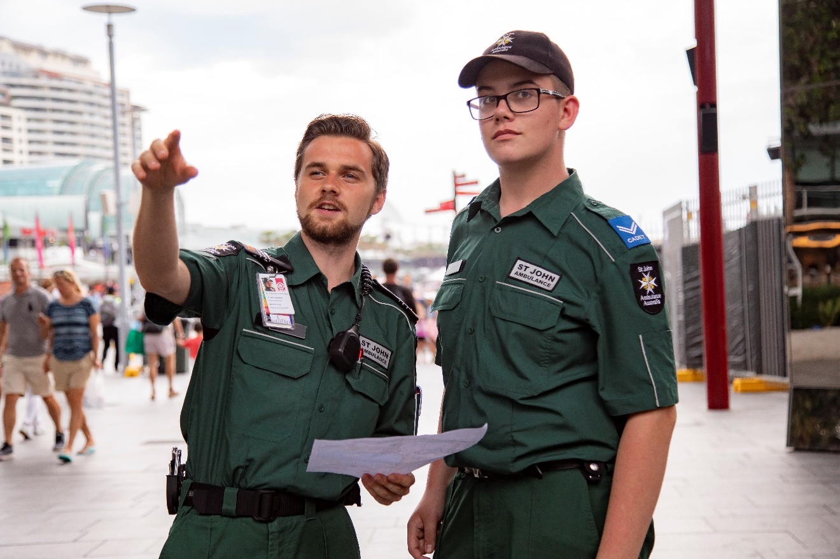
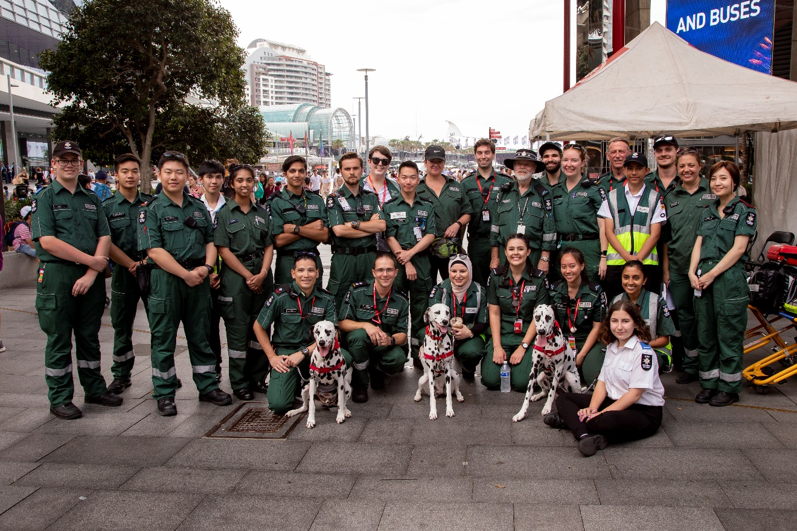
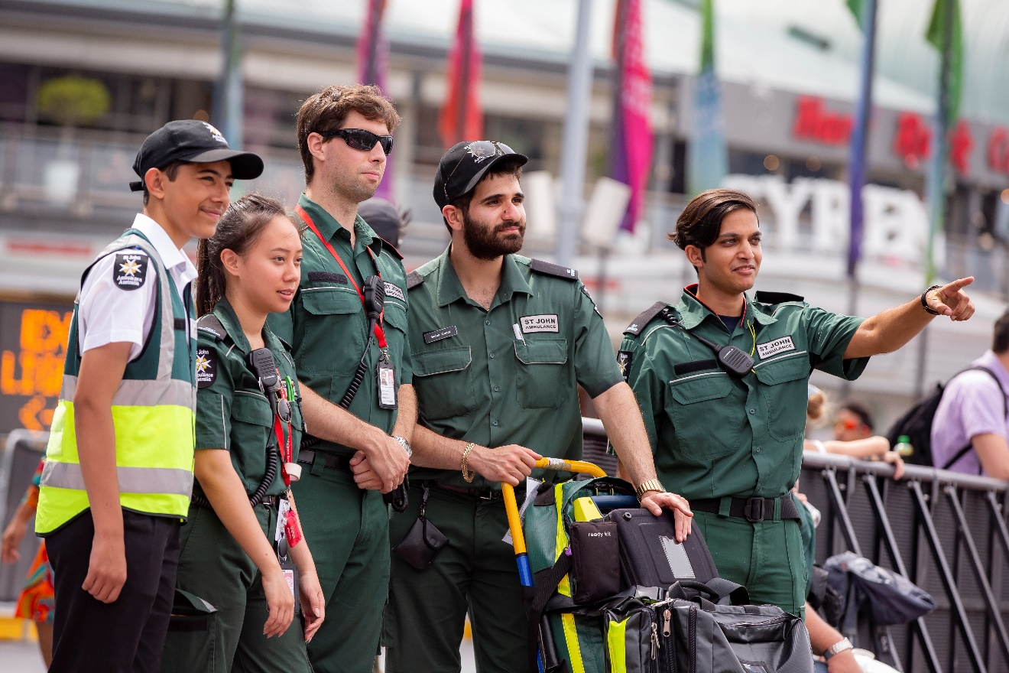
Creating a Collaborative Approach
New combined Corporate and Volunteer Executive Team Structure
Created new combined Volunteer Zone and Hubs
Created Volunteer Advisory and Youth Leaders to provide support across St John NSW
Created Support Services across organisation (Peer Support, Chaplaincy, EAP) and Investigation Teams within PPC Team
Partnerships – Child Safety, Health & Safety, Volunteer Information Portal, Leadership Program Facilitators

Slide 24
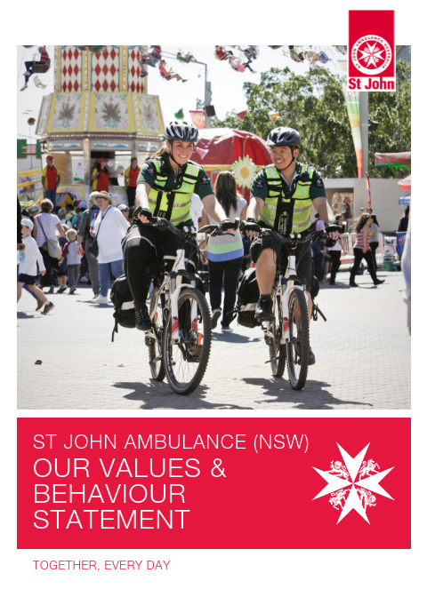
Leadership Program Focus
Creating a consistent approach to Leadership Development and coaching
The Face to Face Workshop:
Authentic based Values Leadership
Developing Ourselves and Others
Empowering Ourselves and Others
Personal Development Plans
Coaching Sessions (3 x 1hour sessions every 4+ weeks) and future support from the networks built – keep the connections going!
Volunteer
Corporate

Slide 25
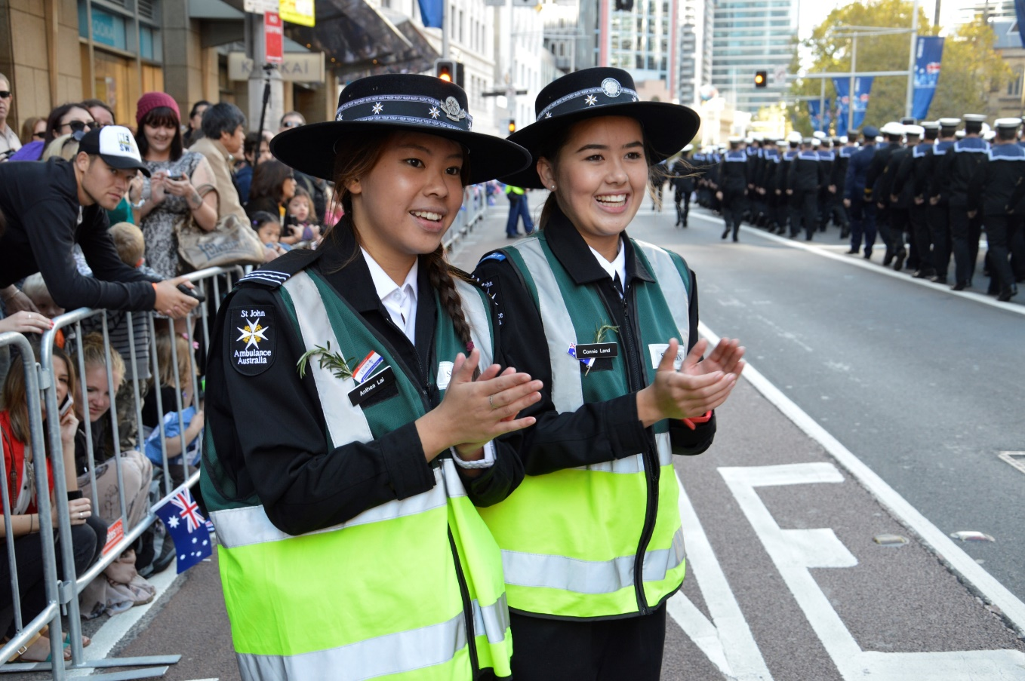
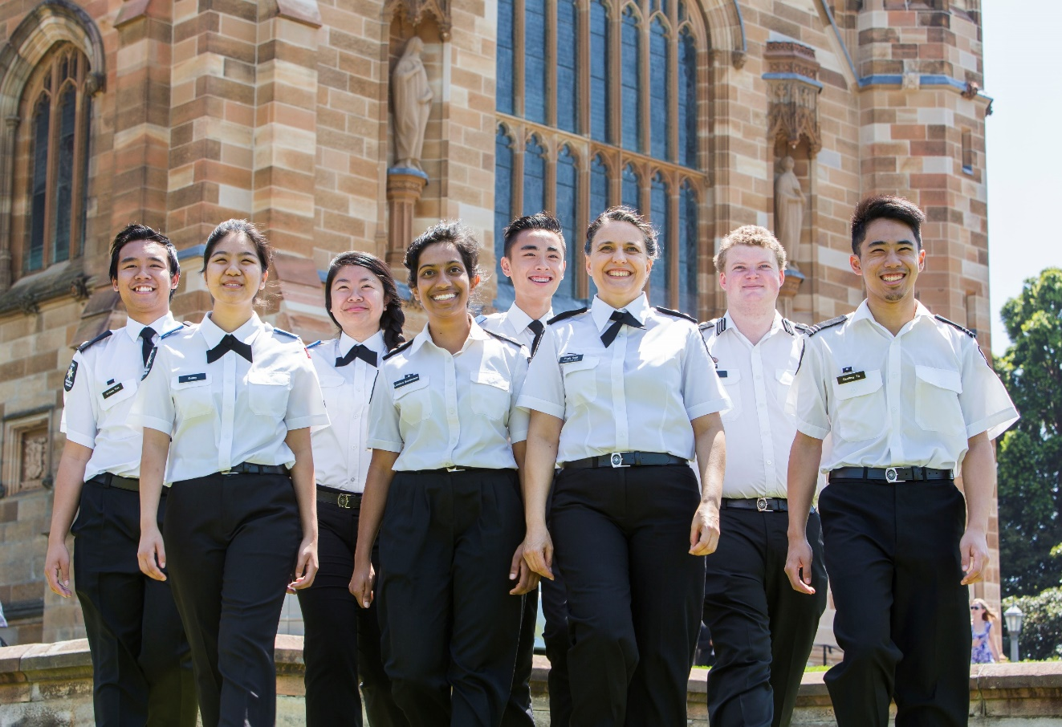
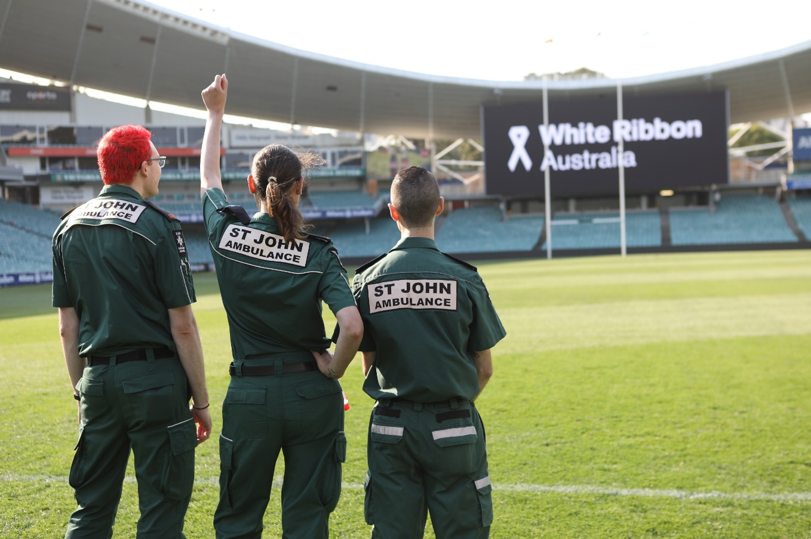
Enabling Members to feel safe
Creating a culture of safety and the pathways for people to speak out
Enabling a culture of reporting and calling out the below the line behaviours
Showing our commitment and care about the rights and wellbeing of children to become a leader in child safety in the not-for-profit arena
Creating a volunteer and youth project team to implement the agreed game plan
Creating the training and embedding our child safety leadership with 48 Child Wellbeing Officers
Corporate

Slide 26
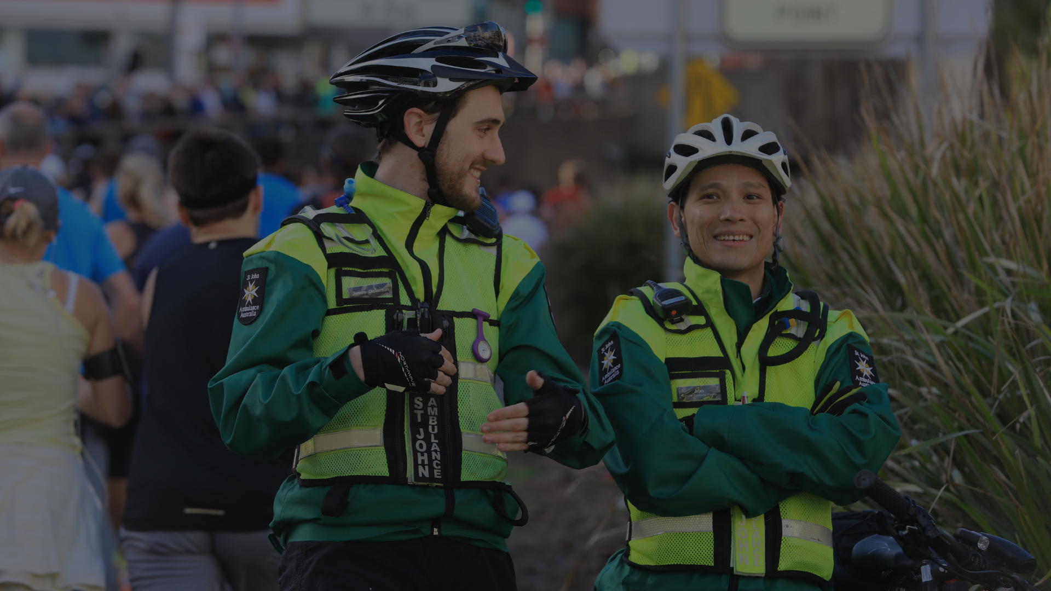
CONCLUSION

Slide 27
So what has been the outcome?

Slide 28
So what has been the outcome?

Slide 29
So what has been the outcome?
We had less than 1/3 of our people on the journey with us. No one knew where we were going or what the strategy was to get there. We now have 2/3 actively participating and supporting change
We have clear strategies, values, engaged leadership teams, a PPC team actively building and supporting the member initiatives, significant improvements in leadership and safety
We still have a long way to go but the priorities are ‘doable’ now that there is a core belief that opinions will be heard and a development of trust that together we can achieve our outcomes

Slide 30
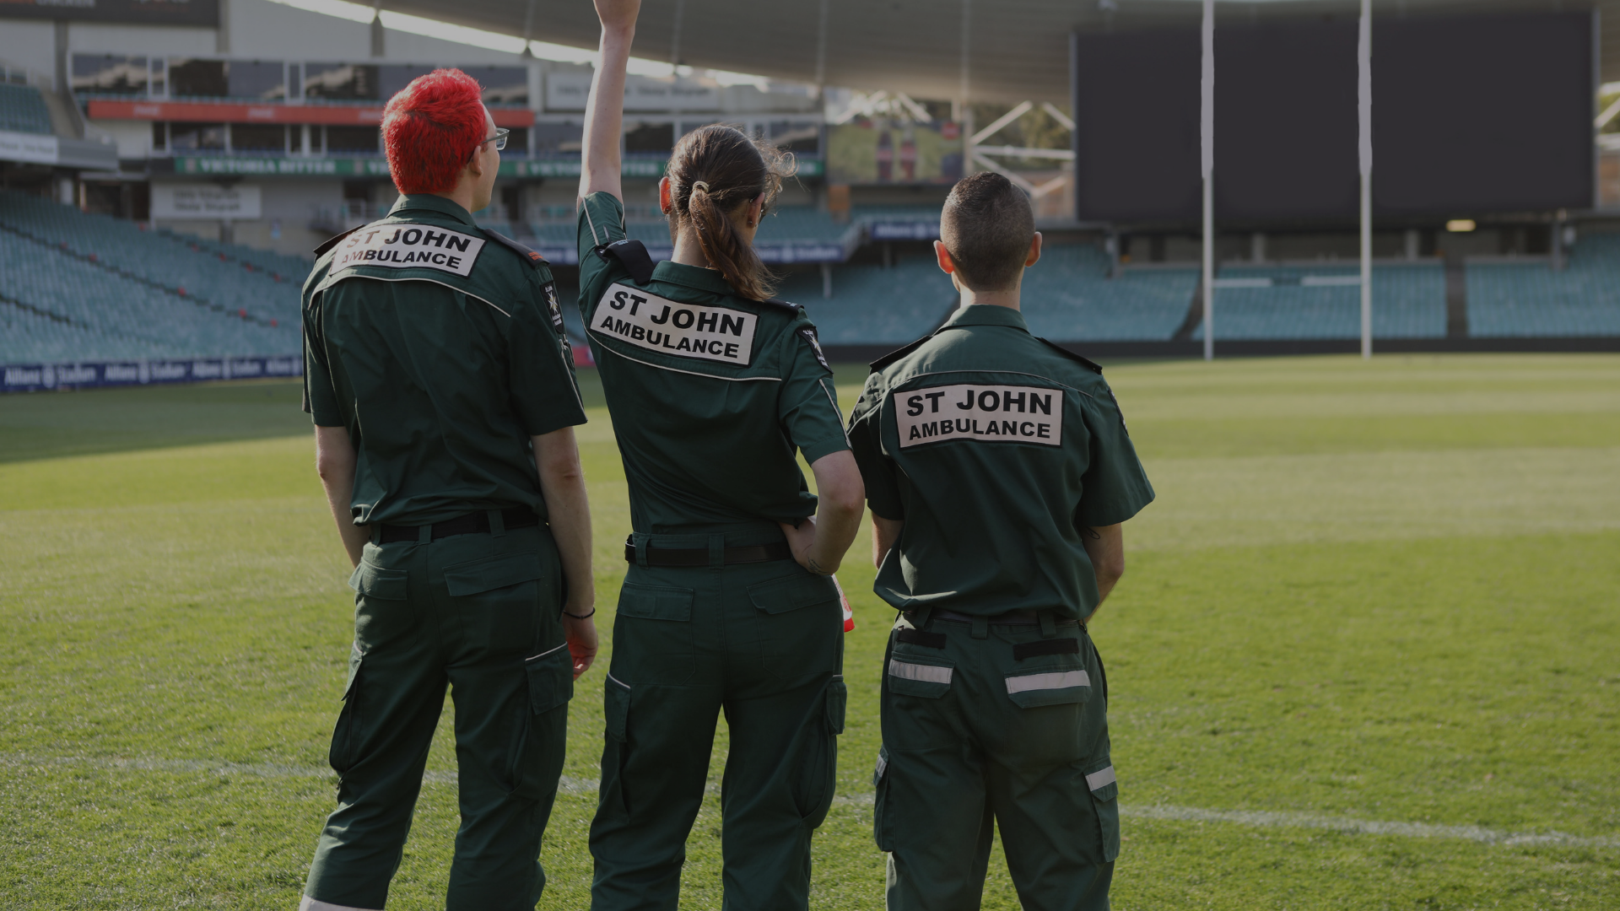
THANK YOU!

